Slide 1
Data Analysis in XLDA
XLDA
MKTG2341 PC Lab Week 9

Slide 2
Today’s Agenda
Part 1: Exporting SNAP to XLDA
Part 2: Data Analysis in XLDA
Calculate Sample Size
Single Response Questions
Categorical Data
Metric Data
Grid Rating Questions
Compare Means (Metric Data)
Summarize Single Response (~ Categorical Data)
Multiple Response Questions

Slide 3
Exporting SNAP to XLDA
See Power Point file:
“2309-09 PC Lab9 Part 1-Snap to XLDA”

Slide 4
Using XL Data Analyst
to
Calculate Sample Size

Slide 5
Calculate Sample Size
ONLY for
probability samples
Open an XLDA file.
Click on Add-ins | XL Data Analyst.
Click Calculate | Sample Size.
You must then enter the estimated p (variability), and you must also enter allowable error.
XLDA provides a sensitivity analysis:
Shows the effects on the sample size of differences in variances and allowable error.

Slide 6
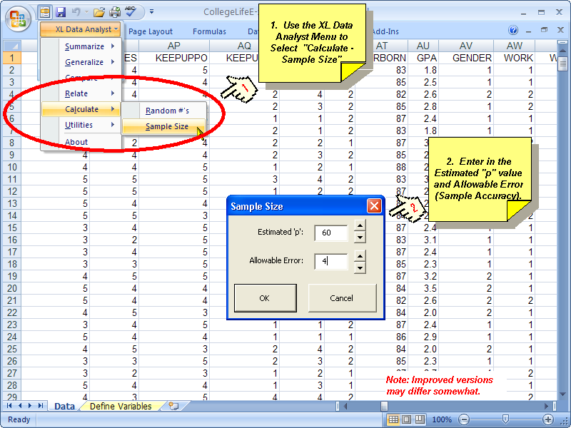
Calculate Sample Size

Slide 7
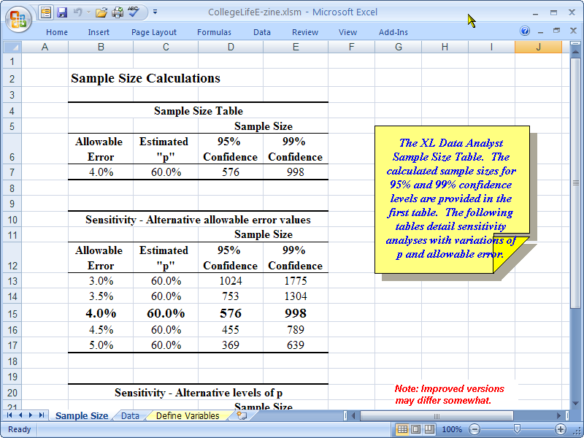
Calculate Sample Size

Slide 8
Using XL Data Analyst
to
Analyze Data

Slide 9
Levels of Data Measurement
Categorical Data:
Nominal: labels only.
Gender: 1=Male, 2=Female.
Ordinal: rank order labels.
Age: 1=Under 18, 2=19-24, 3=25-29, 4=30 and over.
Metric Data:
Rating Scale
Likeliness: 1= Not Likely, 2=Somewhat Unlikely, 3=neutral, 4=Somewhat Likely, 5=very Likely.
Ratio: Real number
How much did you spend today?
Notes:
9

Slide 10

Summarizing Sample Findings
Central Tendency:
Describing the typical response.
Variability:
Describing how similar the respondents are.
Notes:
10

Slide 11
Database
Integrated Case in the text:
The College Life e-Zine
Questionnaire on pg. 278-282
Telephone survey with randomly selected students at the local university.

Slide 12
Summarize Single Response Q
Summarize CATEGORICAL Data:
Q38 What is you academic classification?
___ Freshman
___ Sophomore
___ Junior
___ Senior
___ Grad Student
XLDA Command:
Summarize | Percents
Notes:
12

Slide 13
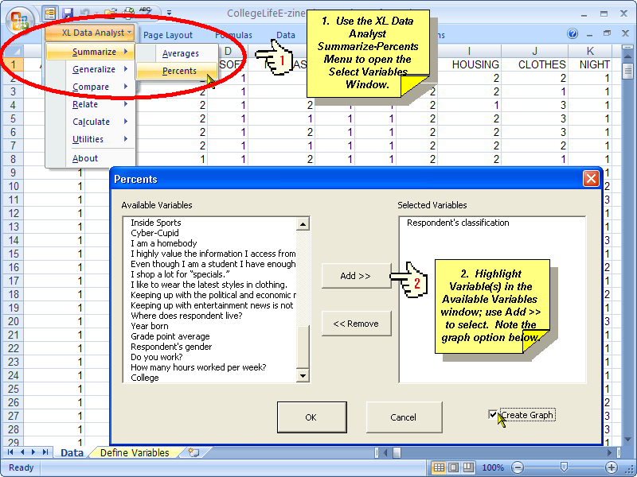
Summarize Single Response Q
Notes:
13

Slide 14
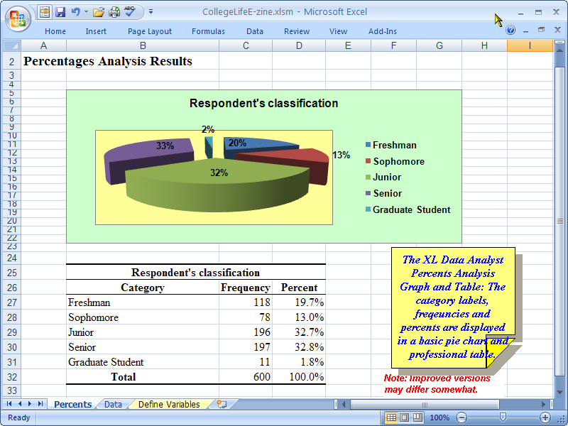
Summarize Single Response Q
Notes:
14

Slide 15
Summarize Single Response Q
Rename the Tab with the sheet name.
Ex: change Percents to Q38Pct
Edit the chart:
If more than 4 answer categories, change to column or bar chart.
Reduce to zero decimals (done in the table).
Add Data Values.
Edit Grid lines if necessary.

Slide 16
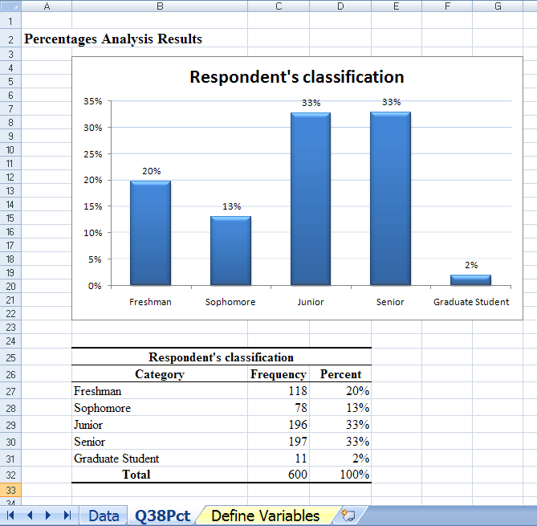
Summarize Single Response Q

Slide 17

Summarize Single Response Q
Summarize METRIC Data:
Q41 What is your Grade Point Average?
________
XLDA Command:
Summarize | Average
Notes:
17

Slide 18
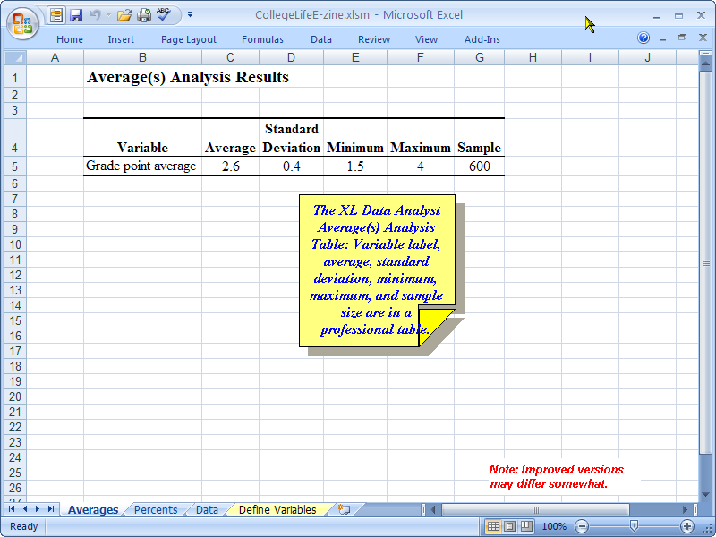
Summarize Single Response Q
Notes:
18

Slide 19
Summarize Grid Q
A Grid Question is Metric Data.
We can compare the Means by moving all the categories in the grid to the analysis window.
XLDA Command:
Summarize | Average

Slide 20
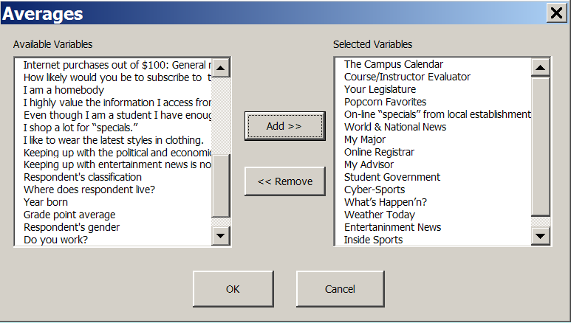
Grid Qs: Compare Means
Analyze all the categories in the Grid Question at the same time to create a comparison table

Slide 21
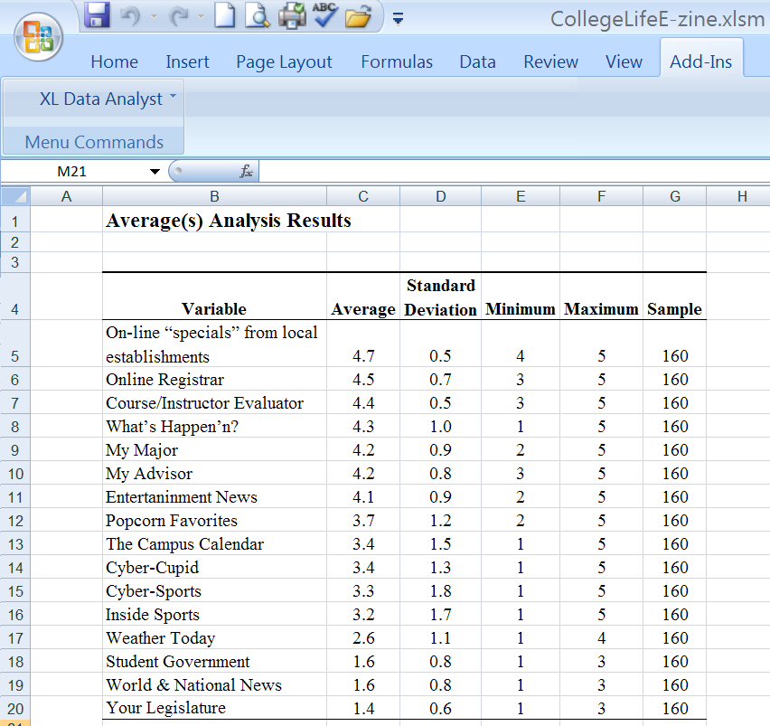
Grid Qs: Compare Means

Slide 22
Grid Qs: Compare Means
Using Excel functions, convert the Average ratings from the table to a Bar Chart.
Edit Chart:
Choose the Quick Style you prefer.
Delete the Legend if the same as the Title.
Make sure you have Data Values.
Edit category labels if too long.
Rename Tab in Excel: Q

Slide 23
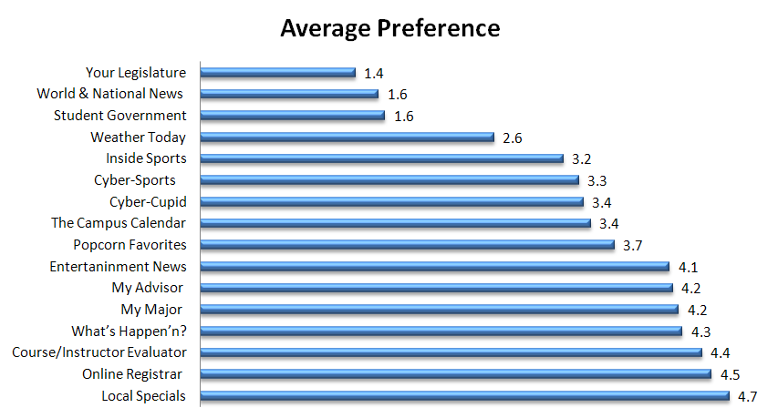
Grid Qs: Compare Means

Slide 24
Grid Qs: Individual Category Analysis
Because the rating questions have labels we can also analyze it using the Percent command.
This useful to identify segments – for example if there are two peaks in the data.
Ex: Campus Calendar on average rated 3.4
XLDA Command:
Summarize | Percents
Move all the grid categories into the window

Slide 25
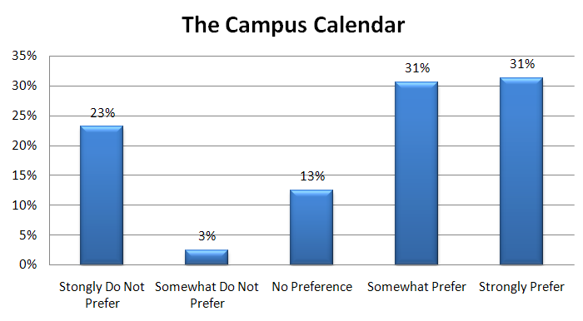
Grid Qs: Individual Category Analysis
Look for segments:
Almost 2/3 of the sample (62%) rated Campus Calendar favourably.
About one quarter do not prefer the Campus Calendar in the E-Zine.

Slide 26
Multiple Response Qs
XLDA does not have an option to analyze Multiple Response questions.
You have two options:
Use Snap 9 (see week 7 PC Lab)
Manually create a table and chart in Excel see posted file:
“2309-09 Wk9 PCLab Part 3-MultiRespQ.xlsx”

Slide 27
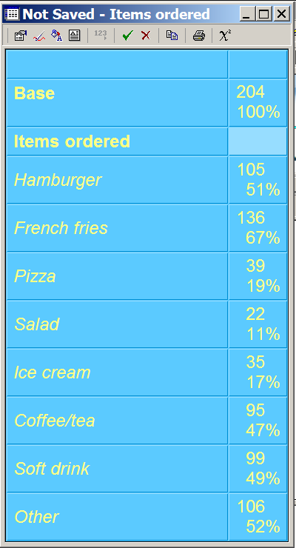
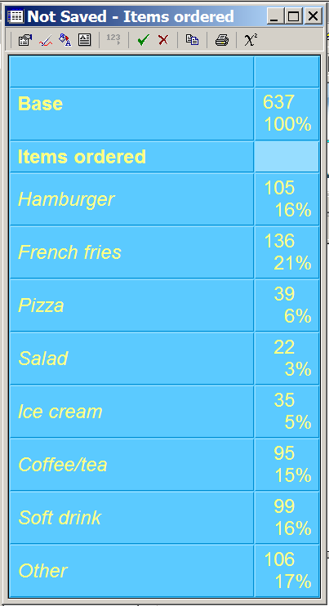

Multiple Response Qs in Snap
From Week 7 PC Lab
You can choose to display the frequency base as:
Respondents
Responses
To switch base click

